Slide 1
Logistic Regression for Online Purchasing Intention
Alexa R. Fisher
MS Data Analytics
Capstone for Western Governors University

Slide 2
Agenda
Introduction
Problem and Hypothesis
Data Analysis Process
Study Findings
Limitations
Proposed Actions
Expected Benefits of Study

Slide 3

Introduction
Wife, Mother to 4, avid reader, and huge T-drama fan
Career change into Data Science
Returned to school in June 2020
BSIT in Oct 2021
MSDA in August 2023

Slide 4
Problem & Hypothesis
Online Purchasing Intention dataset from UC Irvine Machine Learning Repository
(Sakar, 2018)

Slide 5
What attributes within the captured Google Analytics metrics can contribute to the possibility of a customer purchasing an item?
“
”

Slide 6
Null Hypothesis:
The logistic regression model shows that the predictor variable of “Revenue” and the explanatory variables do not have a statistically significant relationship.
Alternate Hypothesis:
The logistic regression model shows a statistically significant relationship between the predictor variable “Revenue” and explanatory variables.

Slide 7
Evaluation Metric
What is predicting model accuracy score?
What would deem a statistically significant relationship between the target and explanatory variables?
(Miyasato, 2020)

Slide 8
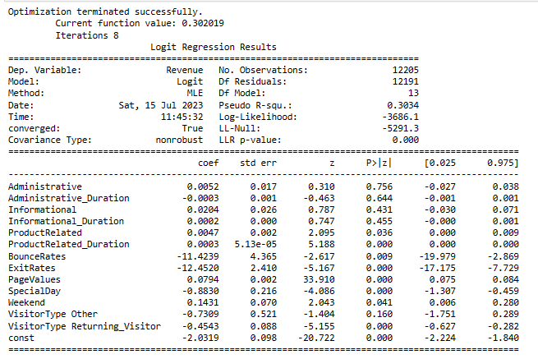
Data Analysis: Initial Regression Modeling
Initial Logistic Regression Model overall model LLR- p-value of 0.0 deeming the model being statistically significant.

Slide 9
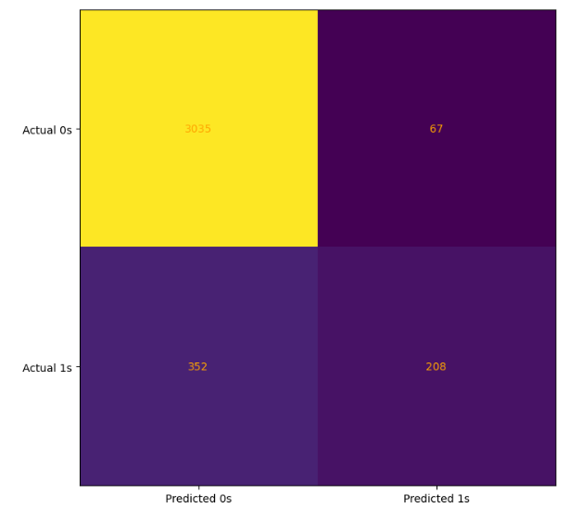
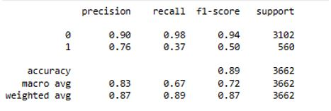
Initial Regression Modeling: Confusion Matrix & Accuracy Score
Initial Confusion Matrix
Accuracy Score
Initial Model 70% of dataset was split into training data, remaining 30% into test data on target and all explanatory variables.

Slide 10
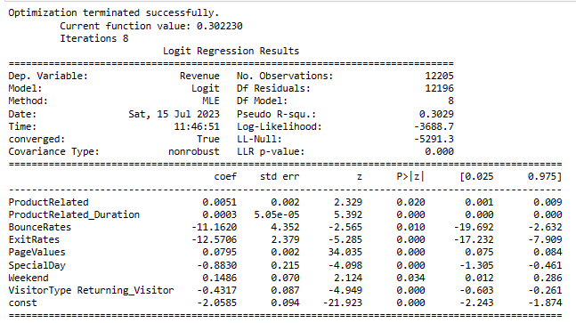
Data Analysis: Optimized Regression Modeling
Initial Model was Optimized with the use of Backward Stepwise Elimination Method to reduce explanatory variables. Only variables with p-value of less than 0.05 deemed statistically significant.

Slide 11

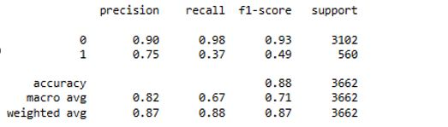
Optimized Regression Modeling: Confusion Matrix & Accuracy Score
Optimized Confusion Matrix
Optimized Accuracy Score
Optimized Model had a slightly worst prediction accuracy score and confusion matrix in comparison to the initial modeling, but overall it was a better representation of the z-statistics showing the strength of each explanatory variable against the target.

Slide 12
Study Findings
Successful optimized regression model
Generated an prediction accuracy score > 80% threshold
Multiple explanatory attributes
Explanatory variables identified with p-value < 0.05 = statistically significant relationships
Reject null hypothesis
Optimized Model met noted evaluation metrics to successfully reject the null hypothesis
Accept alternative hypothesis
Optimized model met all evaluation metrics thresholds for acceptance.
1
2
3
4

Slide 13
Limitations
Lack of specific time period
Missing Observations within Dataset
Limit to a one-year period
Unclear identification of what year captured
Months of January and April missing from captured observations.

Slide 14
Proposed Actions
Investigation of contributions based on Page Values
Marketing Strategies
Customer Retention Efforts
Which website pages had the highest Page Values?
Did these pages have a higher strength in duration?
Was revenue obtained?
Identification of what key features that are increasing page duration
Targeted advertisements
Returning Customers retention via discounts
Next order discount
Specialty Coupons
New User Incentives
Promo codes

Slide 15
Benefits of the Study
Logistic Regression allows for identification of key attributes for improved business strategies in various departments.
Provide insight into which attributes contributed to the target variable occurring.
Marketing Team
Increase revenue occurrence for low performing pages
Sales Team
Identification of high revenue months
Holiday pricing
Customer Retention Team
Targeted advertisements and coupons/discounts

Slide 16
Sources
Kumar, B. (2023, March 6). Google Analytics for Ecommerce in 2023 (Complete Guide). Retrieved from Shopify: https://www.shopify.com/blog/14681601-google-analytics-for-ecommerce-a-beginners-guide
Miyasato, Kenny. (2020, April 5). Classification Report: Precision, Recall, F1-Score, Accuracy.Received from Medium: https://medium.com/@kennymiyasato/classification-report-precision-recall-f1-score-accuracy-16a245a437a5
Sakar, C., & Kastro, Y. (2018). Online Shoppers Purchasing Intention Dataset. Retrieved from UCI Machine Learning Repository: https://doi.org/10.24432/C5F88Q

Slide 17
Thank you
Alexa R. Fisher
MS Data Analytics
Western Governors University

